Slide 1
Accounting Principles

Slide 2
Accounting
Process of analyzing, classifying, recording, summarizing, and interpreting business transactions
One of the key aspects keeping “running totals” of “things.”
Balances and accounts

Slide 3
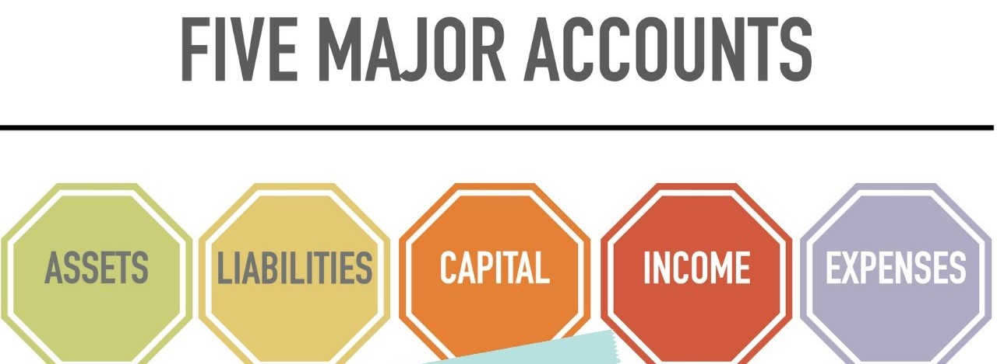

Slide 4
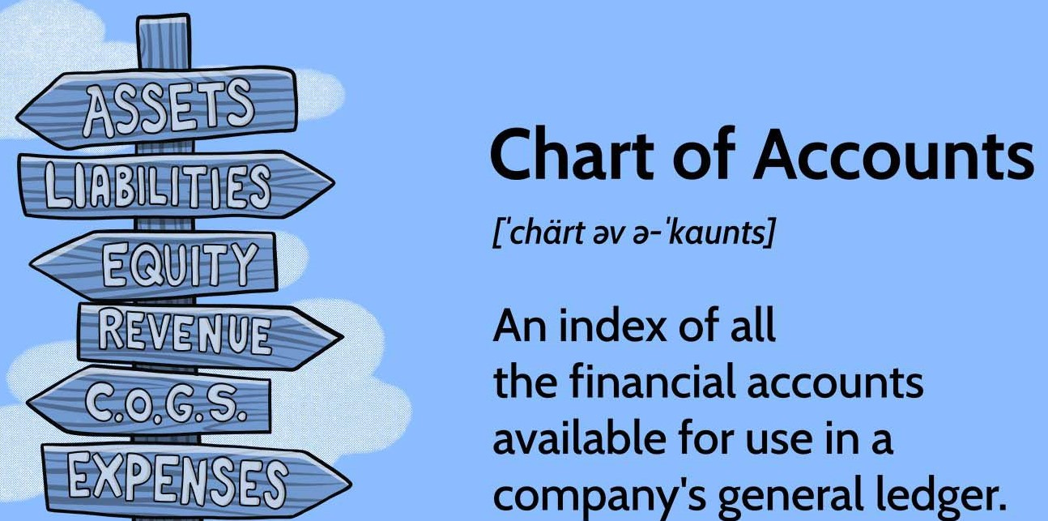
Accounts
Asset → Anything of value that a business owns → Cash
Revenue → Income that results from a business→ Sales revenue, Fees earned
Expenses→ bills and other costs a business must pay in order for it to operate and earn revenue
Wage expenses,Rent expenses, Insurance expenses, Maintenance expenses

Slide 5
Accounts
Liabilities → Debt that a business owes; Claims on asset by outsiders
Capital → Stockholders’ equity; Claims on assets by owners

Slide 6
THE MECHANICS OF THE ACCOUNTING PROCESS

Slide 7
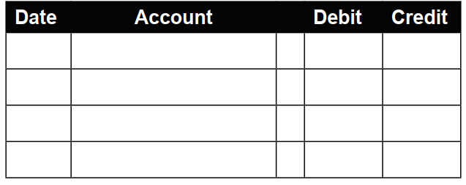
The Journal
Transactions recorded as they happen in chronological order
When a transaction occurs, two or more accounts are affected
Debit on the left side and credit on the right side

Slide 8
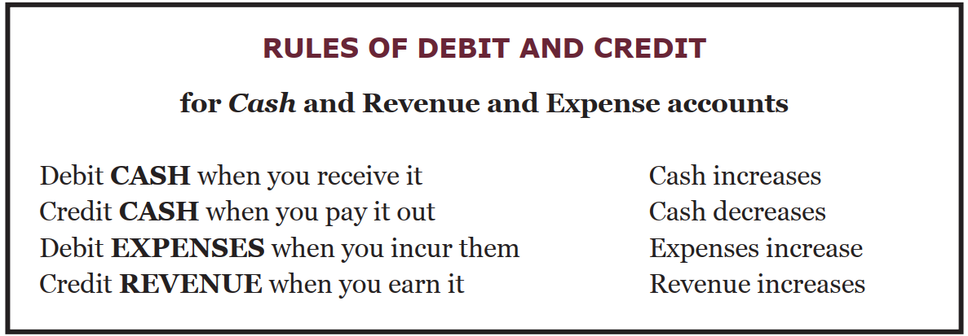
based on
(1) the type of account it is
(2) whether the account is increasing or decreasing.

Slide 9
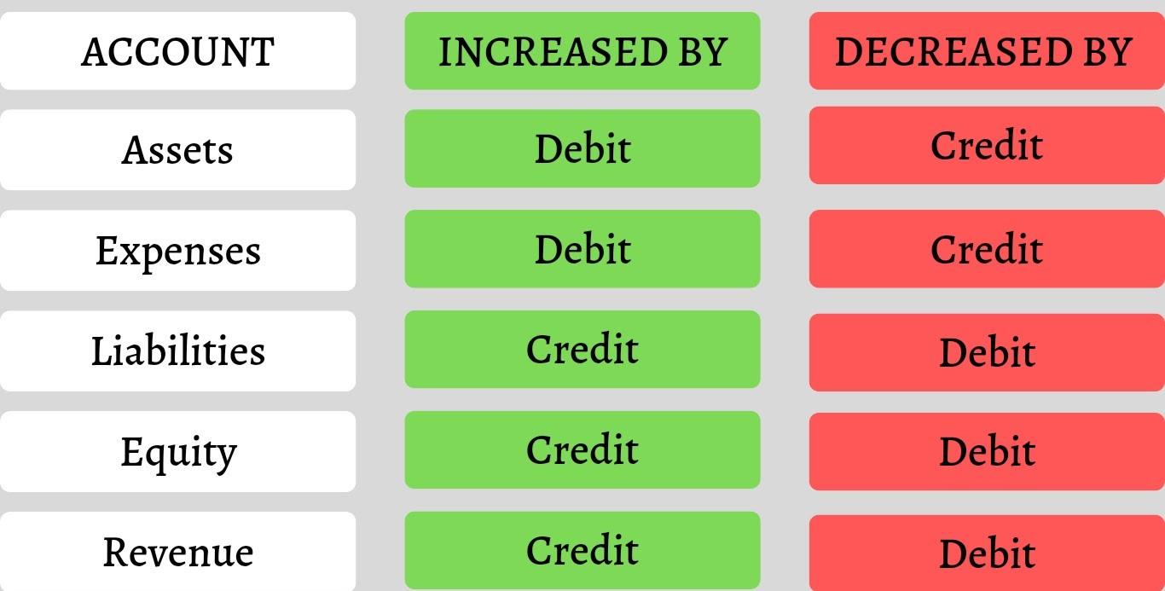
Rules of debit and credit-1

Slide 10
Traditional Approach
Accounts
Personal
Impersonal
Real
Nominal

Slide 11
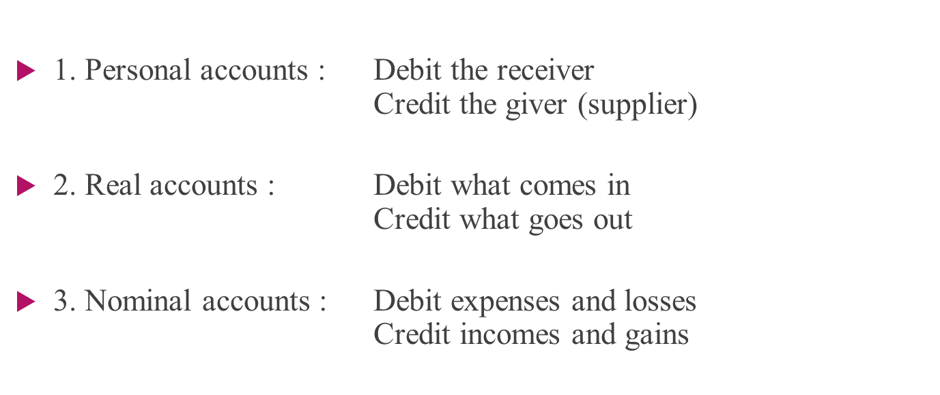
Rules of debit and credit-2

Slide 12
Journalizing Transactions
Journal : The book which is used to enter the transaction
Financial events translated into the language of accounting using the process of journalizing.

Slide 13
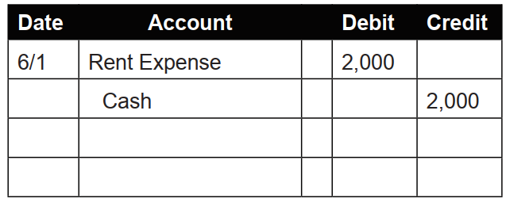
Sample
On 6/1, a company paid rent of $2,000 for the month of June
Rent Expense is an expense account that is increasing. Therefore, it is debited. The account with the debit amount is entered first
Cash is an asset account that is decreasing. Therefore, it is credited. The account with the credit amount is entered next.

Slide 14
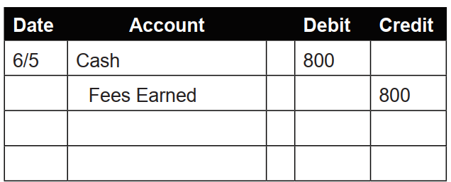
On 6/5, a customer paid $800 cash for services the company provided

Slide 15
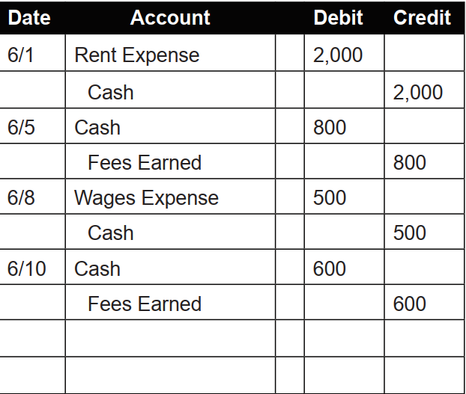

Slide 16
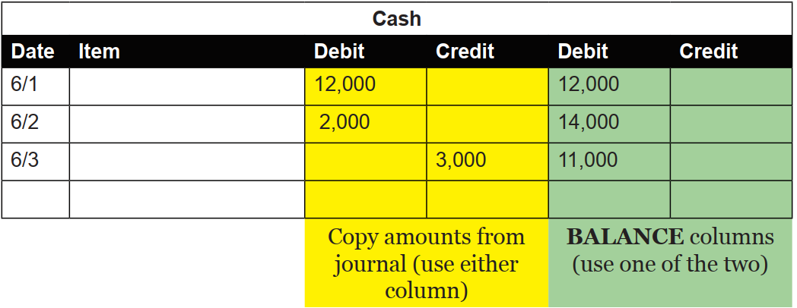
2. Ledger
Individual accounts list in order of account category
ledgers separate information and by account and keep a running balance of each of these accounts

Slide 17
3.Posting
4. Normal Balance
An account’s running balance will accumulate in EITHER the Debit balance column
The column in which its running total is maintained

Slide 18
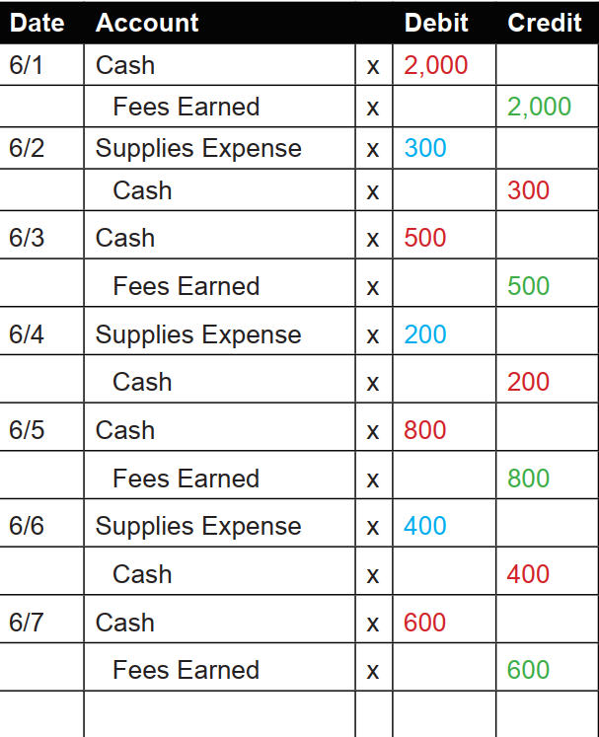
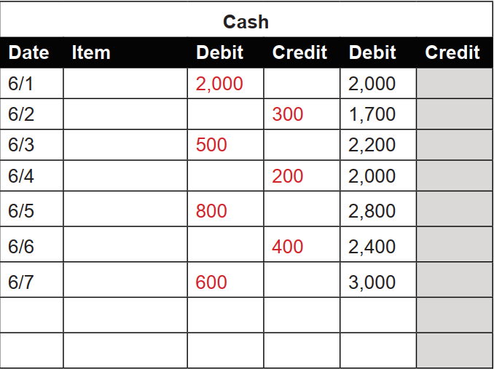

Slide 19
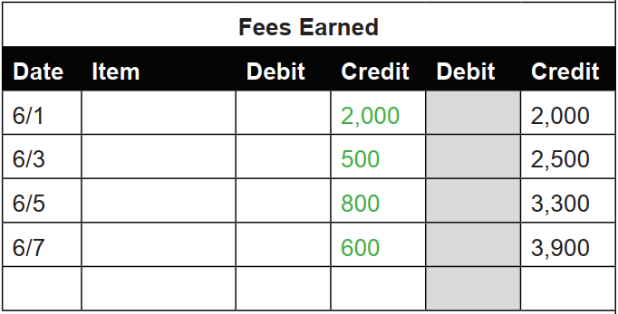
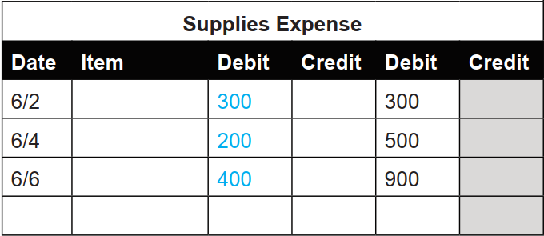

Slide 20
5. Trial Balance
A trial balance is a list of all a business’s accounts and its current ledger balances
May be generated at any time to test whether total debits equals total credits

Slide 21
6. FINANCIAL STATEMENTS
Income statement
Retained earnings statement
The balance sheet
The statement of cash flows

Slide 22
Income Statement
A report that lists and summarizes revenue, expense, and net income information for a period of time.
Revenue - Expenses = Net income
How much profit is it making?
The income statement relies on the matching principle
(it only reports revenue and expenses in a specified window of time)
(expenses to be recognized in the same period as the applicable revenue)

Slide 23
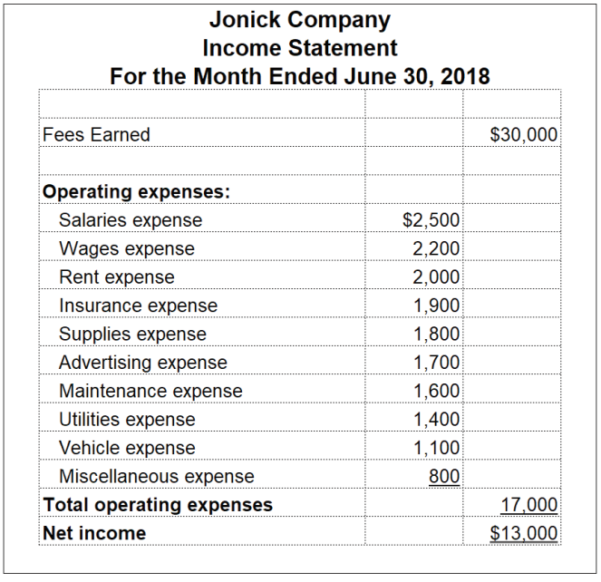
SAMPLE INCOME STATEMENT

Slide 24
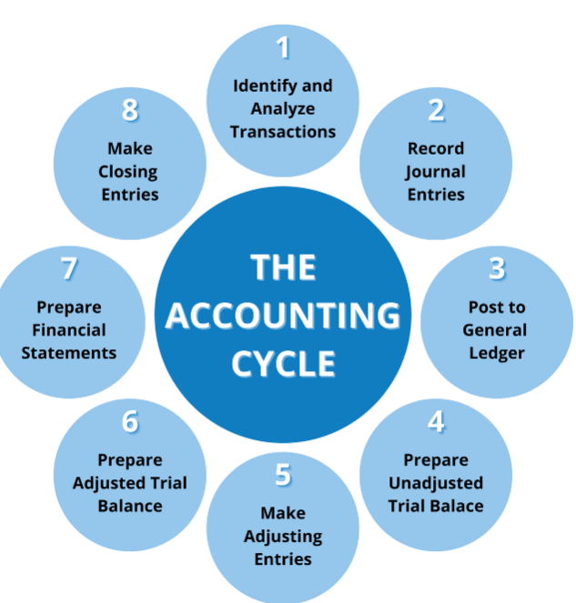
The Accounting Cycle

Slide 25
Closing Entries
Made at the end of the accounting period after the financial statements but before the first transaction in the next month
to set the balances of income statement accounts back to zero
Retained Earnings: Profit at the end of the accounting period is transferred

Slide 26
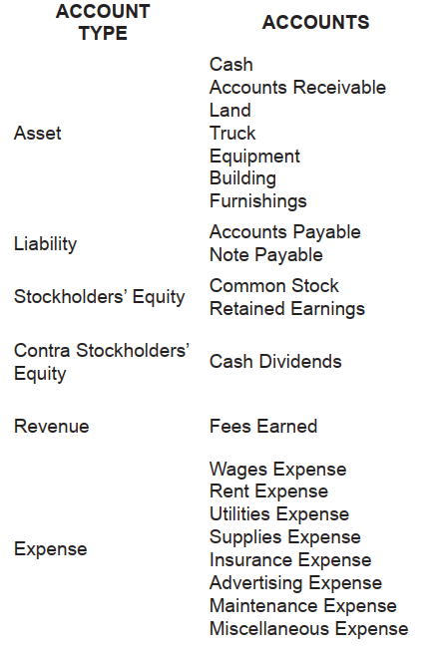
Accounts Summary

Slide 27
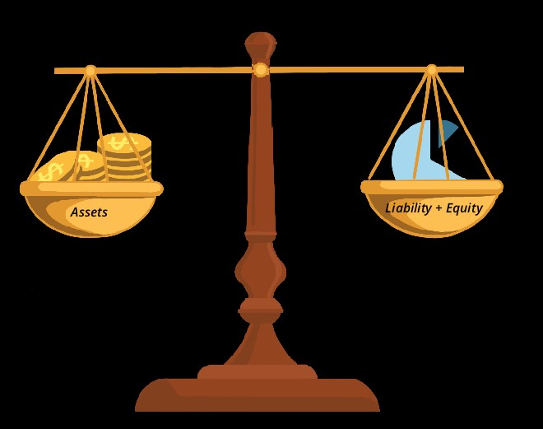
THE ACCOUNTING EQUATION

Slide 28
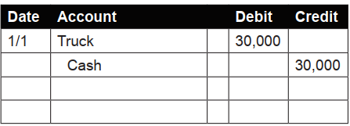
BUYING A TRUCK
Date | Account |  | Debit | Credit
1/1 | Truck |  | 30,000
 | Cash |  |  | 10,000
 | Notes payable |  |  | 20,000

Slide 29
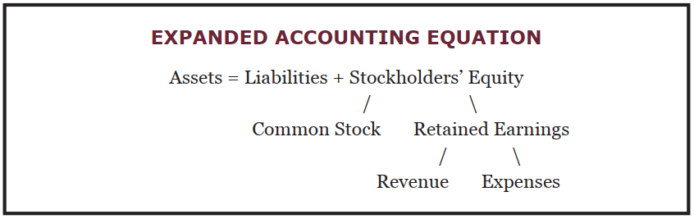
The accounting equation

Slide 30
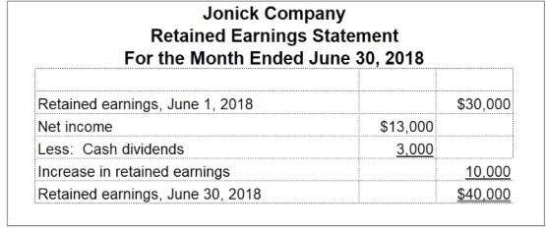
Retained Earnings Statement

